Slide 1
The 3rd International Conference on Photocatalytic and Advanced Oxidation Technologies
for the Treatment of Water, Air, Soil and Surfaces (PAOT-3)
Gdańsk, September 1 - 4 , 2015
Decomposition of Alcohols by Microwave Plasma
Jerzy Mizeraczyk¹, Mariusz Jasiński², Bartosz Hrycak²,
Dariusz Czylkowski², Robert Miotk², Mirosław Dors²
¹Department of Marine Electronics, Gdynia Maritime University, Gdynia, Poland
²Centre for Plasma and Laser Engineering,
The Szewalski Institute of Fluid-Flow Machinery,
Polish Academy of Sciences, Gdańsk, Poland

Slide 2
Outline
Introduction – transformation to the hydrogen-oriented economy
European hydrogen-oriented economy vision
The U.S. Department of Energy’s envisage of hydrogen production target for 2011 – 2020: Energy yield of 60 g H₂/kWh
Can a plasma method approach this target ?
Why the microwave plasmas?
Conventional and plasma methods of hydrogen production from gaseous and liquid fuels (vapourized)
Challenges for a Microwave Plasma Method
Selection of a Microwave Plasma Source (MPS) for hydrogen production:
Waveguide-supplied metal-cylinder-based MPS
Experimental studies of plasma reforming of alcohols
Final results: Energy yield – 43 [g(H₂)/kWh] for methane; 22.2 g(H₂)/kWh for ethanol; 18.6 g(H₂)/kWh for isopropanol
Conclusions

Slide 3
Introduction
Hydrogen is more and more attractive as an efficient and environmental friendly source of energy
It is considered as a promising fuel of the future
General tasks
Developing and implementing systems for hydrogen production from renewable electricity and biomass
Lower the hydrogen production cost and to improve efficiency
Improving existing commercial processes (e.g. steam methane reformation) and development new advanced production techniques (e.g. biological methods, nuclear and solar-powered)
Notes:
3

Slide 4
European hydrogen-oriented economy vision
European roadmap for the production and distribution
of hydrogen, fuel cells and hydrogen systems
H₂ production
& distribution
Direct H₂ production from renewables,
de-carbonised economy
Hydrogen- oriented economy
Widespread H₂ pipeline infrastructure
2050
Interconnection of local H₂ distribution grids,
significant H₂ production from renewables
2040
H₂ produced from fossil fuels with CO₂ sequestration
T R A N S F O R M A T I O N
Market penetration
2030
Distributed H₂ production at refuelling stations (reforming and electrolysis)
2020
FC and H₂ systems
Development & deployment
Reforming natural gas, electrolysis
2010
R&D, tests
Fossil
fuel-based
economy
2000
Source: European Commission 2005:
Hydrogen Energy and Fuel Cells: A vision of our future

Slide 5
Source: Katie Randolph, U.S. Department of Energy, Hydrogen Production,
2013 Annual Merit Review and Peer Evaluation Meeting, May 16, 2013
DOE’s envisage of hydrogen production targets in distributed and central scales for the period 2011 – 2020
 | $/kg (production costs only) | 2011 Status Target | 2015 Target | 2020 Target | Ultimate Production Target
Distributed | Electrolysis from grid electricity | $4.20 | $3.90 | $2.30 | $1-$2
 | Bio-derived Liquids (based on ethanol reforming case) | $6.60 | $5.90 | $2.30
Central | Electrolysis from renewable electricity | $4.10 | $3.00 | $2.00
 | Biomass gasification | $2.20 | $2.10 | $2.00
 | Solar thermochemical | NA | $14. 80 | $3.70
 | Photoelectrochemical | NA | $17.30 | $5.70
 | Biological | NA | NA | $9.20
Apportionment of Threshold Cost: $1-$2/kg for production, $1-$2/kg for delivery
Based on the 2012 DOE-FCTP MYRD&D cost status and targets for Hydrogen Production
http://www1.eere.energy.gov/hydrogenandfuelcells/mypp/pdfs/production.pdf

Slide 6
United States Department of Energy 2013
(confirmed in 2015)
Hydrogen Production Goal and Pathway Strategies
Objective:
Develop technologies to produce hydrogen from clean,
domestic resources at a production cost of $1-$2/kg H₂ by 2020
Estimated Plant Capacity (kg/day)
Distributed systems: up to 1500
Central systems: 50 000, 100 000, ≥ 500000
What does it mean in a „scientific” language?
Cost of 1 kWh electric energy in the USA in April 2014 – $0.12
$2/kg H₂ → kg H₂/$2 → – Target of the U.S. DOE by 2020
Can a plasma method approach this target?
60 g H₂/kWh

Slide 7
Plasmas at atmospheric pressure
Advantages:
Plasma systems are gas flowing systems, possible radial or axial injection of the operating gas in the plasma region, controllable atmosphere in the reactor (neutral, oxidizing, reducing);
possible high gas flow rate and controlled power
wide range of temperatures [ 3.10²-10⁴ K ]
high electron density [~10¹⁵ cm⁻³]
fast heat transfer rate
high efficiency of energy conversion to reactants
enhanced reaction kinetics
low, moderate and high power-handling capability
small size of the reactor
relatively low investment cost
Possible application in the distributed hydrogen production systems ?

Slide 8
Conventional and plasma methods of H₂ production
Comparison of the production rates and energy yields
Production method | Initial composition | Production rate g(H₂)/h | Energy yield g(H₂)/kWh | References
Gaseous fuel
Conventional steam reforming of methane (catalyst) | CH₄ + H₂O+ Air |  | 60 Established industrial process | K. Randolph, U.S. DOE, 2013, [3]
Dielectric barrier discharge | CH₄ + H₂O |  | 3.6 | T. Kappes et al., 2002, [25]
Dielectric barrier discharge | CH₄ + Air | 0.13 | 6.7 | M. Heintze, B. Pietruszka, 2004, [26]
Dielectric barrier discharge | CH₄ + CO₂ | 0.25 | 5.2 | M. Dors et al., 2012, [27]
Dielectric barrier discharge | CH₄ + CO₂ / H₂O |  | 0.5 | B. Sarmiento et al., 2007,[8 ]
Spark discharge | CH₄ + CO₂ | 0.4 | 17.3 | V. Shapoval et al, 2015 [28]
Gliding arc | CH₄ + H₂O + Air |  | 40 | J.M. Cormie, I. Rusu, 2001, [29]
Plasmatron arc | CH₄ + H₂O + Air |  | 280 | L. Bromberg et al., 2000, [30]
Metal-cylinder-based microwave plasma | CH₄ + CO₂ + H₂O | 180 | 42.9 | M. Jasiński et al., 2013, 4.5 kW, [31]
Waveguide supplied resonant-cavity-based microwave plasma with catalyst | CH₄ + H₂O | 169 | 62.8 | M. Jasiński et al., 2014, 2.5 kW, [32]

Slide 9
Conventional and plasma methods of H₂ production
Comparison of the production rates and energy yields
Production method | Initial composition | Production rate g(H₂)/h | Energy yield g(H₂)/kWh | References
Liquid (vaporized) fuels
Water electrolysis | H₂O |  | 20 - 40 | K. Randolph, U.S. DOE, 2013, [3]
Gliding arc (water spray) | H₂O + Ar | 0.004 | 13 | R. Burlica et al., 2010, [33]
Dielectric barrier discharge | CH₃OH + CO₂ / H₂O C₂H₅OH + CO₂ |  | 3.3 6.7 | B. Sarmiento et al., 2007, [7]
Gliding arc (alcohol spray) | CH₃OH + Ar | 0.08 | 176 | R. Burlica et al., 2011, [23]
Laval nozzle arc | C₂H₅OH + H₂O+ Air | 18 | 100 | C. Du et al., 2012, [34]
Microwave (2.45 GHz) plasma | CH₃OH + Ar C₂H₅OH + H₂O + Ar | 0.6 0.3 | 1.4 0.5 | J. Henriques et al., 2011, [35]
Microwave (2.45 GHz) plasma | C₂H₅OH + Ar |  | 0.55 | D. Tsyganov et al., 2013, [36]
Microwave (2.45 GHz) plasma | CH₃OH + Ar C₂H₅OH + H₂O + Ar |  | 0.29 0.41 | N. Bundaleska et al., 2013, [37]
Microwave (2.45 GHz) plasma | C₂H₅OH + Ar | --- | 0.37 | R. Rincon et al., 2014, [R1]

Slide 10
Hydrogen production processes
 | Methane | Ethanol | Isopropanol
Pyrolysis | CH₄ → 2H₂ + C | C₂H₅OH → 3H₂ + CO + C | C₃H₇OH → 4H₂ + CO + 2C
Dry reformig | CH₄ + CO₂ → 2H₂ + 2CO | C₂H₅OH + CO₂ → 3H₂ + 3CO | C₃H₇OH + 2CO₂ → 4H₂ + 5CO
Steam reforming | CH₄ + 2H₂O → 4H₂ + CO₂ | C₂H₅OH + 3H₂O → 6H₂ + 2CO₂ | C₃H₇OH + 5H₂O → 9H₂ + 3CO₂
 | CH₄ + H₂O → 3H₂ + CO | C₂H₅OH + H₂O → 4H₂ + 2CO | C₃H₇OH + 2H₂O → 6H₂ +3CO
Partial oxidation | 2CH₄ + O₂ → 2CO + 4 H₂ | 2C₂H₅OH + O₂ → 6H₂ + 4CO | C₃H₇OH + O₂ → 4H₂ + 3CO
Combined steam reforming | CH₄ + H₂O → 3H₂ + CO CH₄ + CO₂ → 2H₂ + 2CO CO + H₂O → H₂ + CO₂ | C₂H₅OH + H₂O → 4H₂ + 2CO C₂H₅OH + CO₂ → 3H₂ + 3CO CO + H₂O → H₂ + CO₂ | C₃H₇OH + 2H₂O → 6H₂ +3CO C₃H₇OH + 2CO₂ → 4H₂ + 5CO CO + H₂O → H₂ + CO₂
Auto-thermal reforming | 2CH₄ + O₂ + CO₂ → 3CO + 3H₂ + H₂O 4CH₄ + O₂ + 2H₂O → 4CO + 10H₂ | C₂H₅OH + O₂ + CO₂ → 3CO + H₂ + 2H₂O 4C₂H₅OH + O₂ + 2H₂O → 8CO + 14H₂ | C₃H₇OH + O₂ + CO₂ → 4CO + 6H₂ + H₂O 2C₃H₇OH + O₂ + 2H₂O → 6CO + 10H₂
Endothermic
Exothermic
Neutral
Pyrolysis (Direct decomposition)

Slide 11
Research proposal
Plasma hydrogen production from alcohols
Ethanol (C₂H₅OH)
Isopropanol (C₃H₇OH)
using microwave plasmas (915 MHz, 2.45 GHz)
Challenges for Microwave Plasma
Reliable Microwave Plasma Source (MPS)
Energy yield - 60 g H₂/kWh
High hydrogen production rate

Slide 12
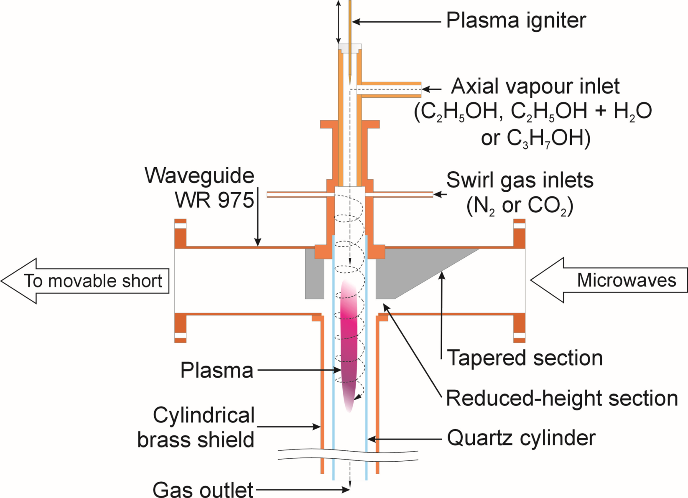
Waveguide-supplied metal-cylinder-based MPS
(with or without an inner dielectric tube)
for hydrogen production

Slide 13
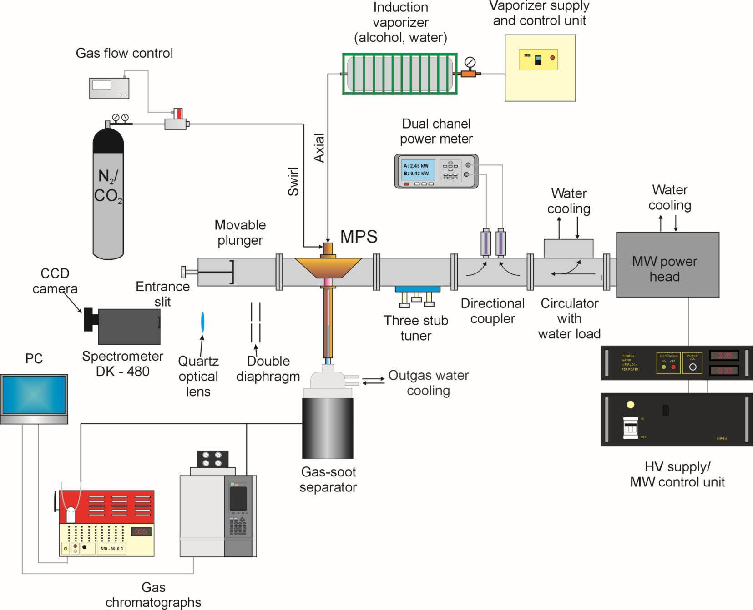
Experimental setup
Diagram of the experimental setup for hydrogen production via alcohol conversion

Slide 14
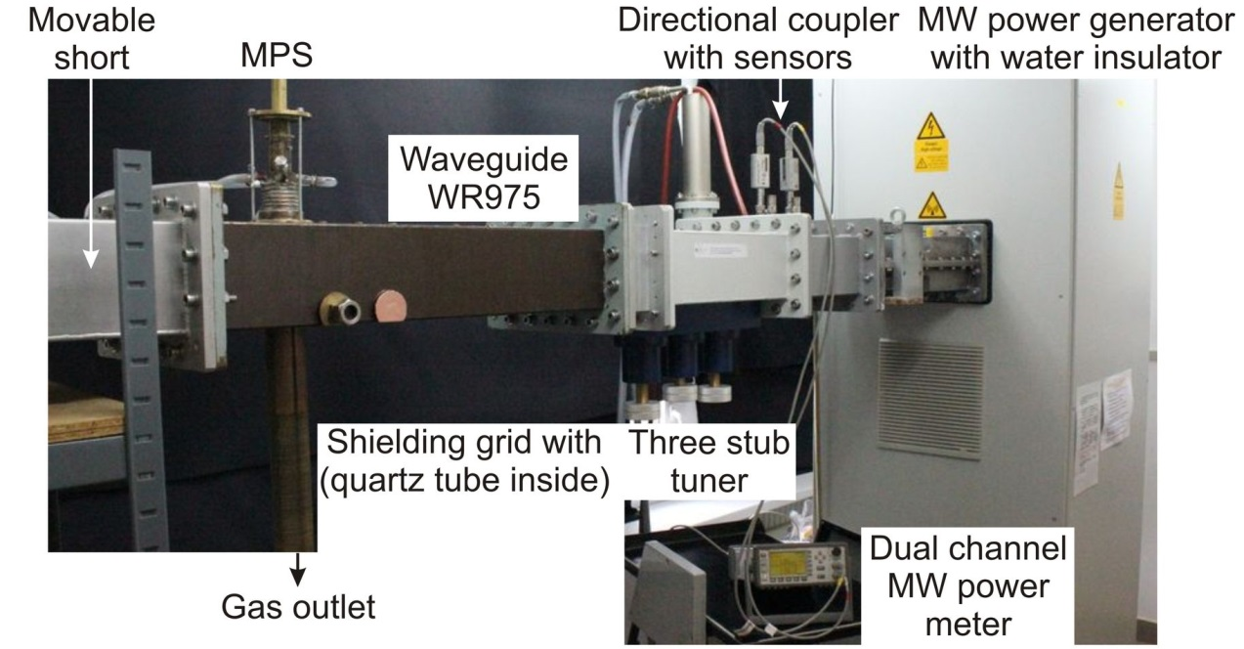
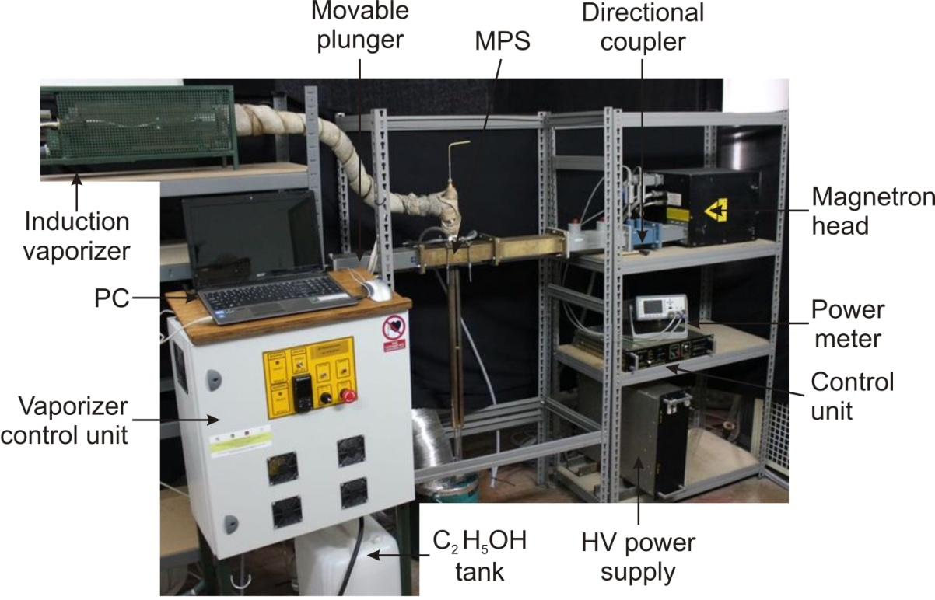
Experimental setup
915 MHz microwave system
up to 20 kW
2.45 GHz microwave system
up to 6 kW

Slide 15
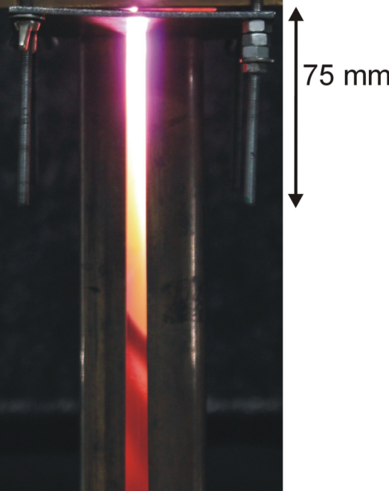
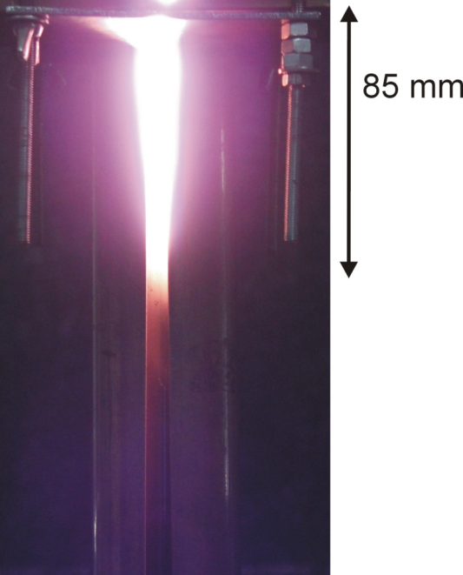
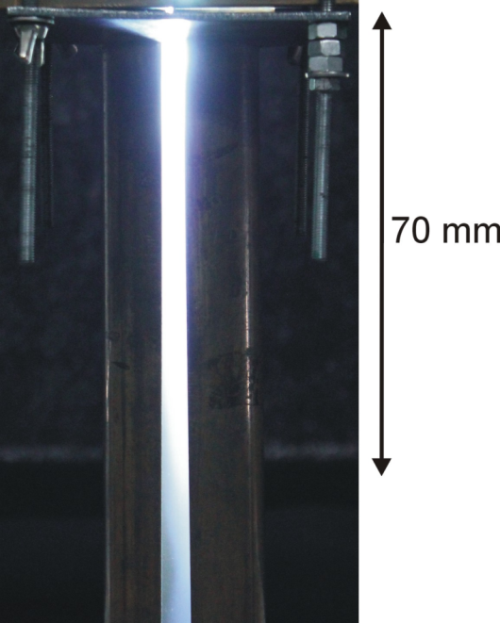
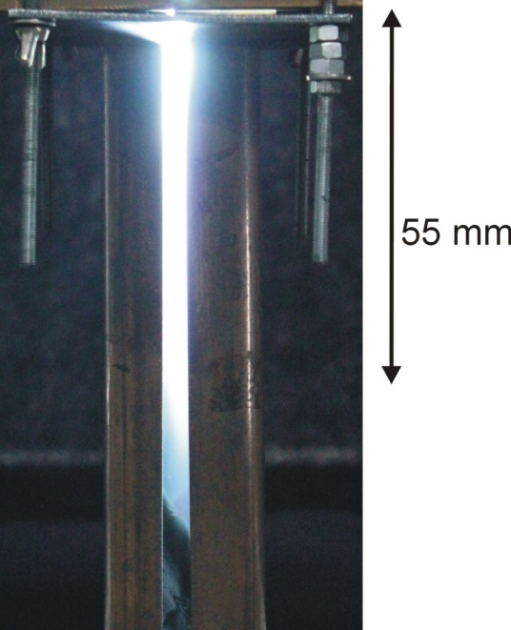
The microwave plasma flame
N₂
CO₂
without C₂H₅OH
with 3 % C₂H₅OH
without C₂H₅OH
with 3% C₂H₅OH
Side view of N₂ and (N₂+C₂H₅OH) plasmas. 2.45 GHz plasma system, absorbed microwave power P_{A} - 2 kW, N₂ flow rate ‑ 2700 NL/h.
Side view of CO₂ and (CO₂ +C₂H₅OH) plasmas. 2.45 GHz plasma system, absorbed microwave power P_{A} - 2 kW,
CO₂ flow rate ‑ 2700 NL/h.

Slide 16
Hydrogen production – efficiency parameters
Hydrogen production rate in g(H₂)/h determines how many grams of hydrogen is produced per a unit of time.
Energy yield of hydrogen production in g(H₂)/kWh determines the amount of grams of hydrogen produced using 1 kWh of microwave energy (also is the ratio of the hydrogen production rate to absorbed microwave power in kW).
Total alcohol conversion degree is given by
[(C_{X}H_{[2X+1]}OH)_{converted} / (C_{X}H_{[2X+1]}OH)_{initial}] × 100%,
(C_{X}H _{[2X+1]} OH)_{initial} is the total mass of introduced alcohol
(C_{X}H _{[2X+1]} OH)_{converted} is the converted mass of alcohol.
The hydrogen selectivity is the percentage of H₂ molecules contained in the introduced alcohol converted into free H₂ molecules
(N_{H2} / 3 × N_{C2H5OH}) × 100% for ethanol
(N_{H2} / 4 × N_{C3H7OH}) × 100% for isopropanol
N_{H2} is the number of produced H₂ molecules, N_{C2H5OH} and N_{C3H7OH} are the initial numbers of ethanol and isopropanol molecules, respectively.
Notes:
16

Slide 17
Experimental parameters
Microwave plasma source
Waveguide-supplied metal-cylinder-based MPS
Processes
Pyrolysis
C_{X}H_{[2X+1]}OH → [X+1]H₂ + CO + [X-1]C
Dry reforming
C_{X}H_{[2X+1]}OH + [X-1]CO₂ → [X+1]H₂ + [2X-1]CO
Steam reforming (ethanol only)
C_{X}H_{[2X+1]}OH + [2X-1]H₂O → [3X]H₂ + [X]CO₂
C_{X}H_{[2X+1]}OH + [X-1]H₂O → [2X]H₂ + [X]CO
Results
H₂ production rate [g(H₂)/h]
Energy yield of H₂ production [g(H₂)/kWh]
H₂ selectivity [%]
Concentrations [vol. %] of: H₂, Ar, O₂, N₂, CO, CO₂, CH₄, C₂H₂, C₂H₄, C₂H₆ at the reactor output
Variable parameters
Microwave frequency: 915 MHz, 2.45 GHz
Absorbed microwave power: 2 – 5.5 kW
Working gases (N₂ or CO₂) flow rate: up to 3900 NL/h
Alcohol flow rate: 0.4 – 2.4 kg/h (pyrolysis, dry reforming), 0.4 – 0.8 kg/h (steam reforming)
Water vapour: 0.5 – 1 kg/h (steam reforming)
Notes:
17

Slide 18
Hydrogen production from alcohols - the best results
 | Plasma gas composition | Absorbed microwave power [kW] | Hydrogen production rate [g(H₂)/h] | Energy yield [g(H₂)/kWh] | Hydrogen selectivity [%]
Pyrolysis | N₂ – 3900 NL/h C₂H₅OH – 0.8 kg/h | 3 (915 MHz system) | 66.7 | 22.2 | 64
 | N₂ – 2700 NL/h C₂H₅OH – 1.2 kg/h | 5 (915 MHz system) | 95.7 | 19.1 | 61
Dry reforming | CO₂ – 2700 NL/h C₂H₅OH – 1.6 kg/h | 5 (915 MHz system) | 59.5 | 11.9 | 29.8
 | CO₂ – 2700 NL/h C₃H₇OH – 2.4 kg/h | 5 (915 MHz system) | 92.9 | 18.6 | 29.6
Steam reforming | N₂ – 2700 NL/h C₂H₅OH – 0.4 kg/h H₂O – 0.5 kg/h | 2 (2.45 GHz system) | 43.6 | 21.8 | 84
 | N₂ – 2700 NL/h C₂H₅OH – 0.6 kg/h H₂O – 0.75 kg/h | 4 (2.45 GHz system) | 64.0 | 16.0 | 82

Slide 19
Microwave plasma processing of alcohols
Performance
Microwave system - 915 MHz (generally better energy parameters)
Processing (pyrolysis, dry and steam reforming) - comparable
Alcohols – comparable (isopropanol inclined to produce soot)
Hydrogen production rate
better for 915 MHz
comparable for all processes
constant when increasing microwave power (2-6 kW)
decreases with increasing working gas flow rate
increases with increasing alcohol concentration (saturation)
Hydrogen energy yield
better for 915 MHz
comparable for all processes
decreases with increasing microwave power
decreases with increasing working gas flow rate
increases with increasing alcohol concentration (saturation)

Slide 20
Problems
Soot production – discharge choking (during pyrolysis of isopropanol)
Possible improvements
Alcohol delivery system
Quenching (to protect from reverse reactions)
Partial oxidation processing
2C₂H₅OH + O₂ → 6H₂ + 4CO
(C₂H₅OH + 3O₂ → 3H₂O + 2CO₂ (Avoid the complete oxidation ! )
C₃H₇OH + O₂ → 4H₂ + 3CO
Auto-thermal reforming:
Alcohol + H₂O + O₂ (Air) (Steam-oxidative reforming)
Alcohol + CO₂ + O₂ (Air)

Slide 21
Conventional and plasma methods of H₂ production
Comparison of the production rates and energy yields
Production method | Initial composition | Production rate g(H₂)/h | Energy yield g(H₂)/kWh | References
Liquid (vaporized) fuels
Water electrolysis | H₂O |  | 20 - 40 | K. Randolph, U.S. DOE, 2013, [3]
Gliding arc (water spray) | H₂O + Ar | 0.004 | 13 | R. Burlica et al., 2010, [33]
Dielectric barrier discharge | CH₃OH + CO₂ / H₂O C₂H₅OH + CO₂ |  | 3.3 6.7 | B. Sarmiento et al., 2007, [7]
Gliding arc (alcohol spray) | CH₃OH + Ar | 0.08 | 176 | R. Burlica et al., 2011, [23]
Laval nozzle arc | C₂H₅OH + H₂O + Air | 18 | 100 | C. Du et al., 2012, [34]
Microwave (2.45 GHz) plasma | CH₃OH + Ar C₂H₅OH + H₂O + Ar | 0.6 0.3 | 1.4 0.5 | J. Henriques et al., 2011, [35]
Microwave (2.45 GHz) plasma | C₂H₅OH + Ar |  | 0.55 | D. Tsyganov et al., 2013, [36]
Microwave (2.45 GHz) plasma | CH₃OH + Ar C₂H₅OH + H₂O + Ar |  | 0.29 0.41 | N. Bundaleska et al., 2013, [37]
Microwave (2.45 GHz) plasma | C₂H₅OH + Ar |  | 0.37 | R. Rincon et al., 2014, [R1]
Microwave (915 MHz) plasma | C₂H₅OH + N₂ | 66.7 | 22.2 | M. Jasinski et al, 2015, [38]
Microwave (915 MHz) plasma | C₂H₅OH + CO₂ | 59.5 | 11.9 | M. Jasinski et al, 2015, [38]
Microwave (915 MHz) plasma | C₃H₇OH + CO₂ | 92.9 | 18.6 | M. Jasinski et al, 2015, [38]
Microwave (2.45 GHz) plasma | C₂H₅OH + H₂O+ N₂ | 43.6 | 21.8 | M. Jasinski et al, 2015, [38]

Slide 22
Summary and conclusions
The investigations showed some advantages of using the metal-cylinder-based MPS:
Operation with various gases (N₂, Ar, CO₂) and mixtures with alcohols
High gas flow rates at atmospheric pressure
Microwave power of several kW
Various plasma-chemical processes can be realized
Soot production occurred at the pyrolysis of isopropanol, even at a low isopropanol vapour flow rate of 0.4 kg/h
The axial delivery of alcohols into the plasma improved microwaves penetration into the reactor tube, reducing soot deposits
The best results of hydrogen production rate and energy yield for ethanol (pyrolysis) were 66.7 g(H₂)/h and 22.2 g(H₂)/kWh, respectively, and for isopropanol (dry reforming) - 92.7 g(H₂)/h and 18.6 g(H₂)/kWh, respectively
The results do not approach DOE’s 2020 target (H₂ energy yield of 60 g(H₂)/kWh). Not yet or never will?

Slide 23
Thank you for your attention!
Authors
R. Miotk¹ B. Hrycak¹ D. Czylkowski¹ M. Dors¹ M. Jasiński¹ J. Mizeraczyk²
¹Centre for Plasma and Laser Engineering,
The Szewalski Institute of Fluid-Flow Machinery,
Polish Academy of Sciences, Gdańsk, Poland
²Department of Marine Electronics, Gdynia Maritime University, Gdynia, Poland

Slide 24
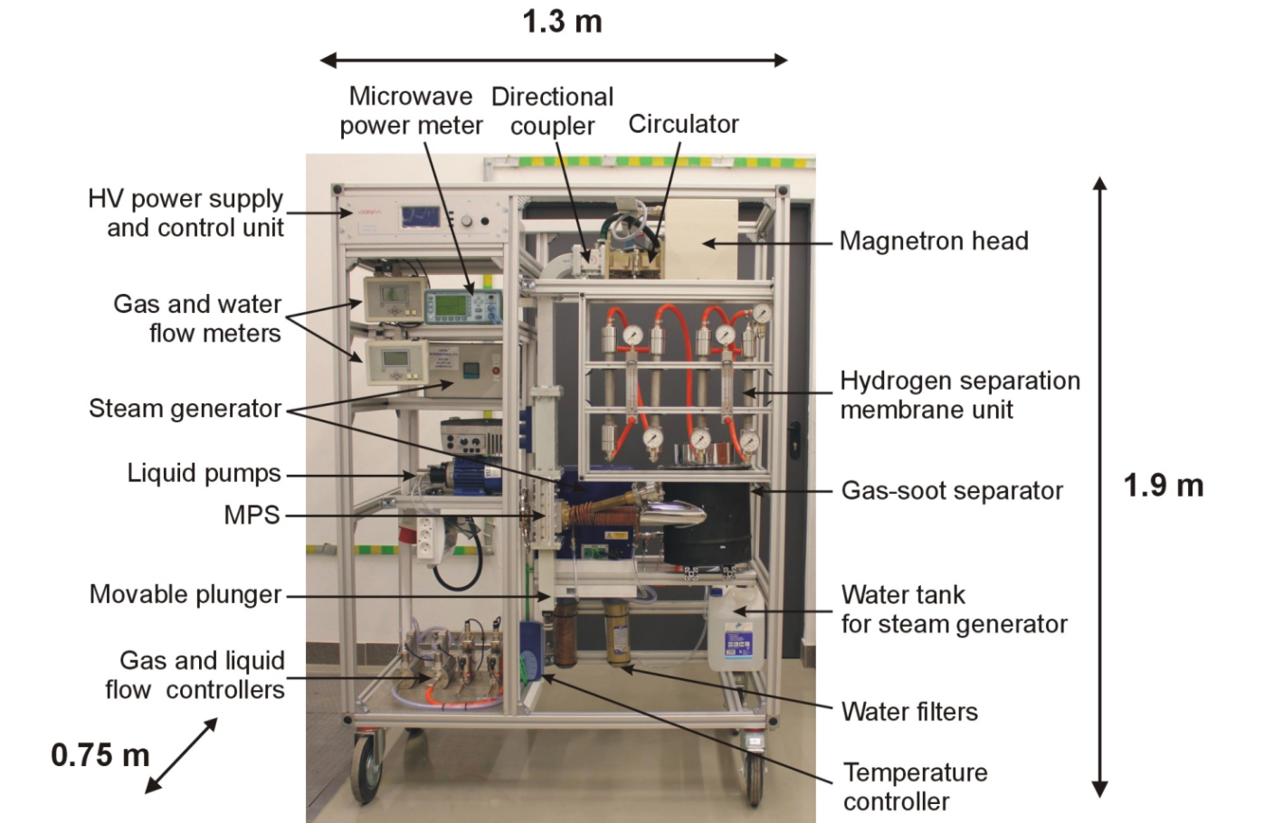
Microwave plasma module for hydrogen production - prototype
Microwaves: up to 6kW
Gas flow rate : up to 12000 NL/h
Jasiński et al., Atmospheric pressure microwave plasma source for hydrogen production, Int J Hydrogen Energy (2013) 38, 11473-11483

Slide 25
Summary and conclusions
The investigations showed some advantages of using the metal-cylinder-based MPS in terms of the performance and hydrogen production rate and energy yield:
Operation with various gases (N₂, Ar, CO₂) and mixtures with alcohols
High gas flow rates at atmospheric pressure
Microwave power of a few kW
Various plasma-chemical processes can be realized
The axial method of introduction of the ethanol into the plasma solved the problem with microwaves penetration and damages of the quartz tube (resulting from soot production) and allowed to improve the production of hydrogen efficiency parameters
For the pyrolysis a problem with soot production occurred when isopropanol was processed, even at a small isopropanol vapour flow rate of 0.4 kg/h
The best results of hydrogen production rate and energy yield for ethanol (pyrolysis) were 66.7 g(H₂)/h and 22.2 g(H₂)/kWh, respectively, and for isopropanol (dry reforming) - 92.7 g(H₂)/h and 18.6 g(H₂)/kWh, respectively
Hydrogen selectivity was up to 100 % for ethanol (pyrolysis) and up to 37% for isopropanol (dry reforming)
The results do not approach DOE’s 2020 target (H₂ energy yield of 60 g(H₂)/kWh). Not yet or never will?

Slide 26
Pyrolysis of ethanol and isopropanol – summary
 |  |  | 2.45 GHz |  |  | 915 MHz
 | Plasma gas composition | Absorbed microwave power [kW] | Hydrogen production rate [g(H₂)/h] | Energy yield [g(H₂)/kWh] | Hydrogen selectivity [%] | Hydrogen production rate [g(H₂)/h] | Energy yield [g(H₂)/kWh] | Hydrogen selectivity [%]
Ethanol | N₂ – 2700 NL/h C₂H₅OH – 0.4 kg/h | 4 | 39.8 | 10.0 | 76 | 43.9 | 11.0 | 84
 | N₂ – 2700 NL/h C₂H₅OH – 0.4 kg/h | 5 | 43.1 | 10.8 | 82.7 | 52.5 | 10.6 | 100
 | N₂ – 3900 NL/h C₂H₅OH – 0.8 kg/h | 3 | 62 | 12.4 | 59.5 | 66.7 | 22.2 | 66
 | N₂ – 3900 NL/h C₂H₅OH – 1.2 kg/h | 5 | no test |  |  | 95.7 | 19.1 | 61
Isopropanol | N₂ – 2700 NL/h C₃H₇OH – 0.4 kg/h | 4 | intense soot production discharge choking |  |  | 33.2 | 8.3 | 63.5
 | N₂ – 2700 NL/h C₃H₇OH – 0.4 kg/h | 5 |  |  |  | 43.5 | 8.7 | 83

Slide 27
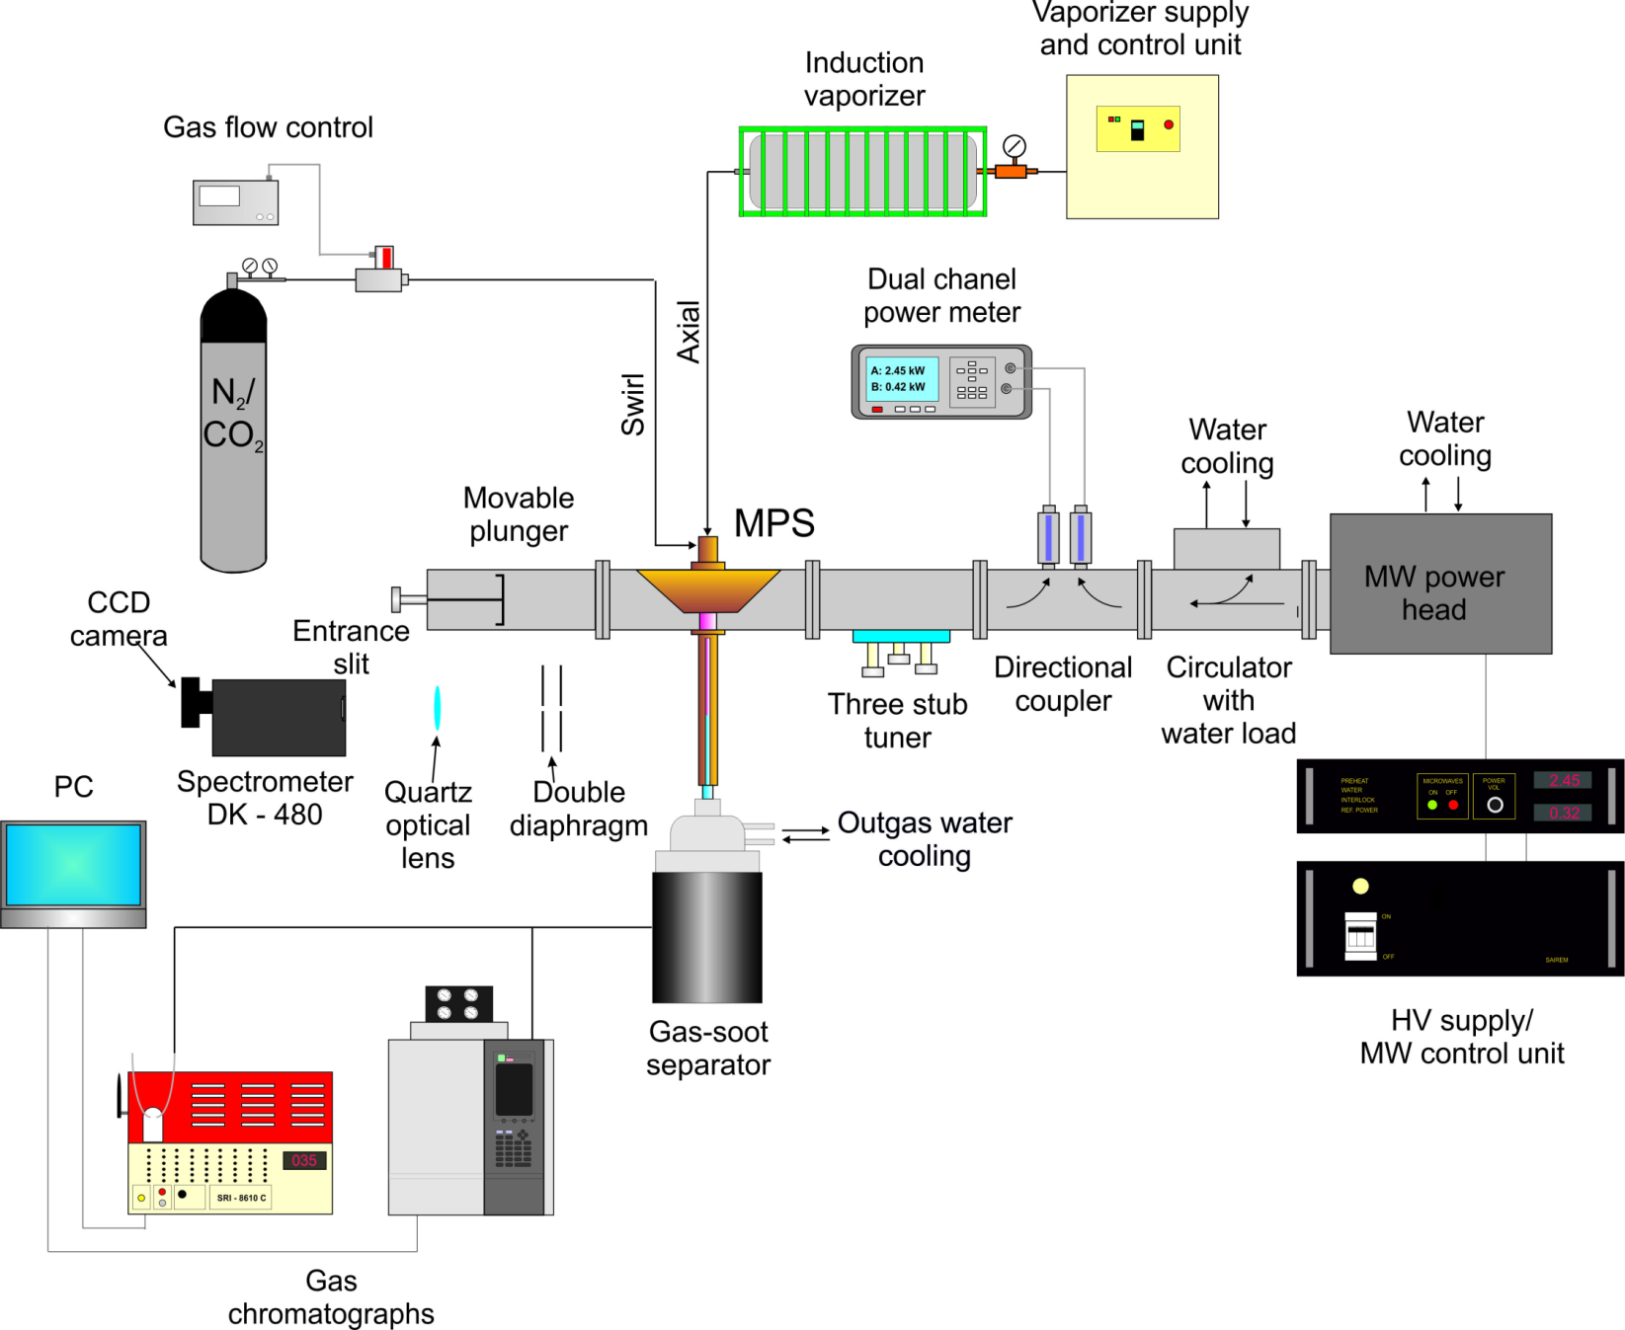
Experimental setup
Diagram of the experimental setup for hydrogen production via alcohol conversion

Slide 28
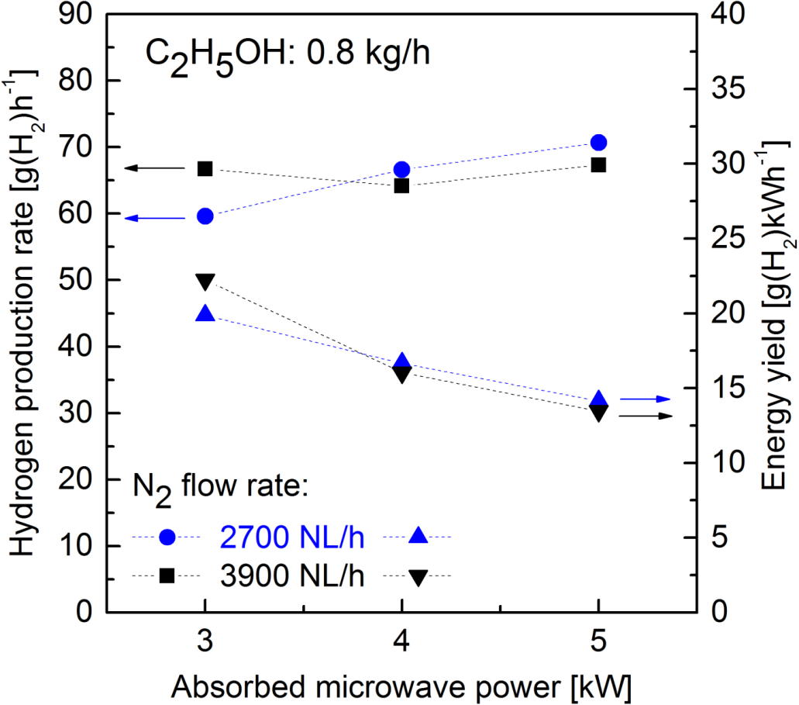
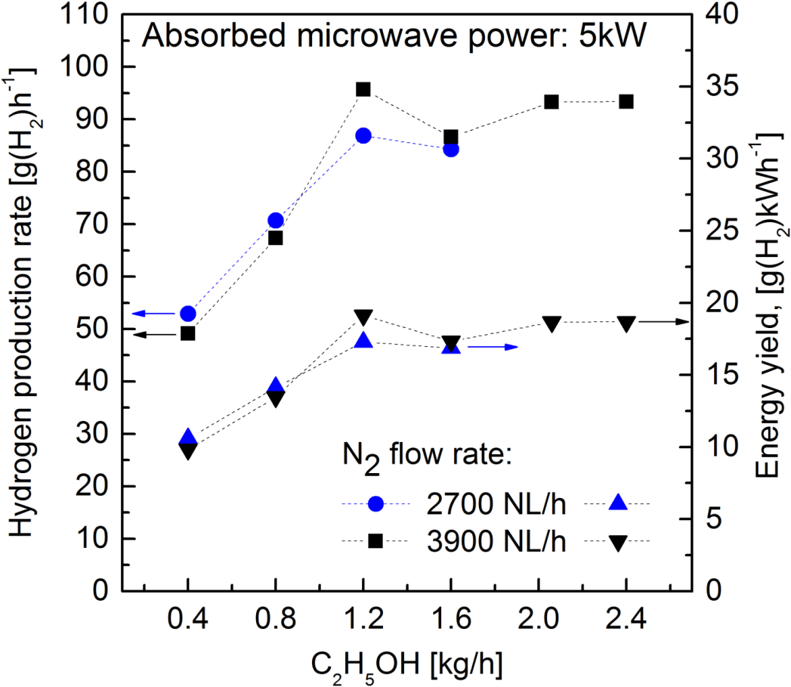
Pyrolysis of ethanol (C₂H₅OH → 3H₂ + CO + C)
915 MHz; C₂H₅OH added to axial flow
Best results: up to 95.7 g(H₂)/h and up to 19.1 g(H₂)/kWh
Ethanol conversion into hydrogen: up to 100%
Hydrogen production rate and energy yield for N₂ plasma as a function of C₂H₅OH flow rate for N₂ flow rate 2700 NL/h (on the left) and 3900 NL/h (on the right).
28
Notes:
28

Slide 29
Dry reforming of ethanol and isopropanol – summary
915 MHz; alcohol added to axial flow
 | Plasma gas composition | Absorbed microwave power [kW] | Hydrogen production rate [g(H₂)/h] | Energy yield [g(H₂)/kWh] | Hydrogen selectivity [%]
Ethanol | CO₂ – 2700 NL/h C₂H₅OH – 1.2 kg/h | 5 | 51.8 | 10.3 | 33.1
 | CO₂ – 2700 NL/h C₂H₅OH – 1.6 kg/h | 5 | 59.5 | 11.9 | 29.8
Isopropanol | N₂ – 2700 NL/h C₃H₇OH – 1.4 kg/h | 5 | 58.0 | 11.6 | 37.0
 | N₂ – 2700 NL/h C₃H₇OH – 2.4 kg/h | 5 | 92.9 | 18.6 | 29.6

Slide 30
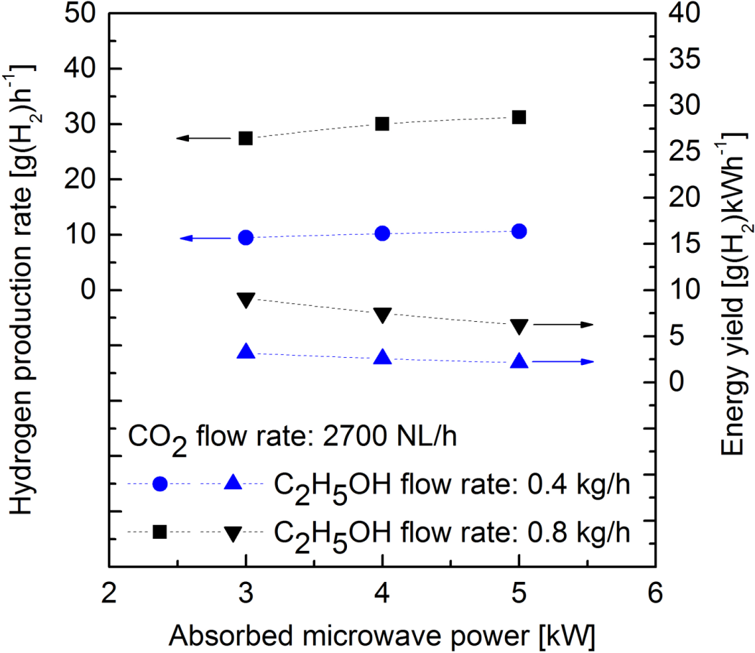
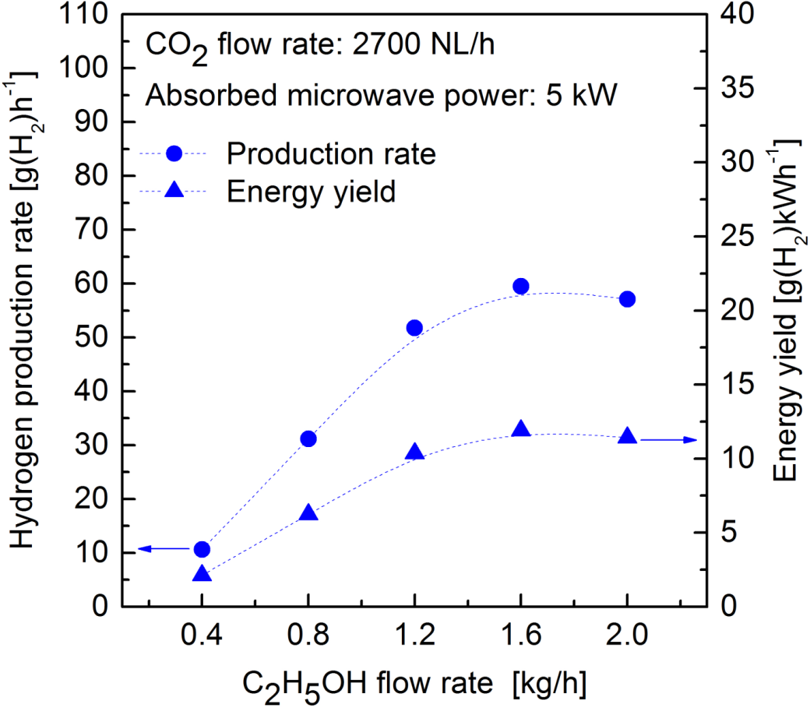
Dry reforming of ethanol (C₂H₅OH + CO₂ → 3H₂ + 3CO)
915 MHz; C₂H₅OH added to axial flow
Best results: up to 59.5 g(H₂)/h and up to 11.9 g(H₂)/kWh
Hydrogen selectivity: up to 33 %
Hydrogen production rate and energy yield for CO₂ plasma as a function of absorbed microwave power (on the left) and as a function of C₂H₅OH flow rate (on the right).
30

Slide 31
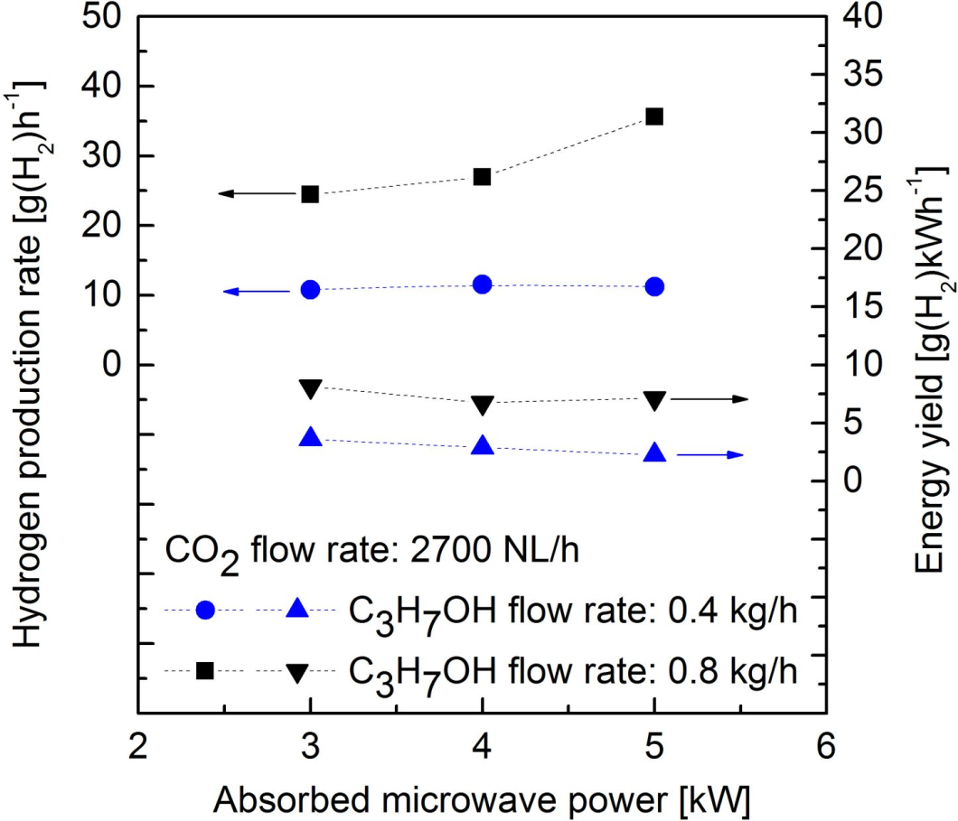
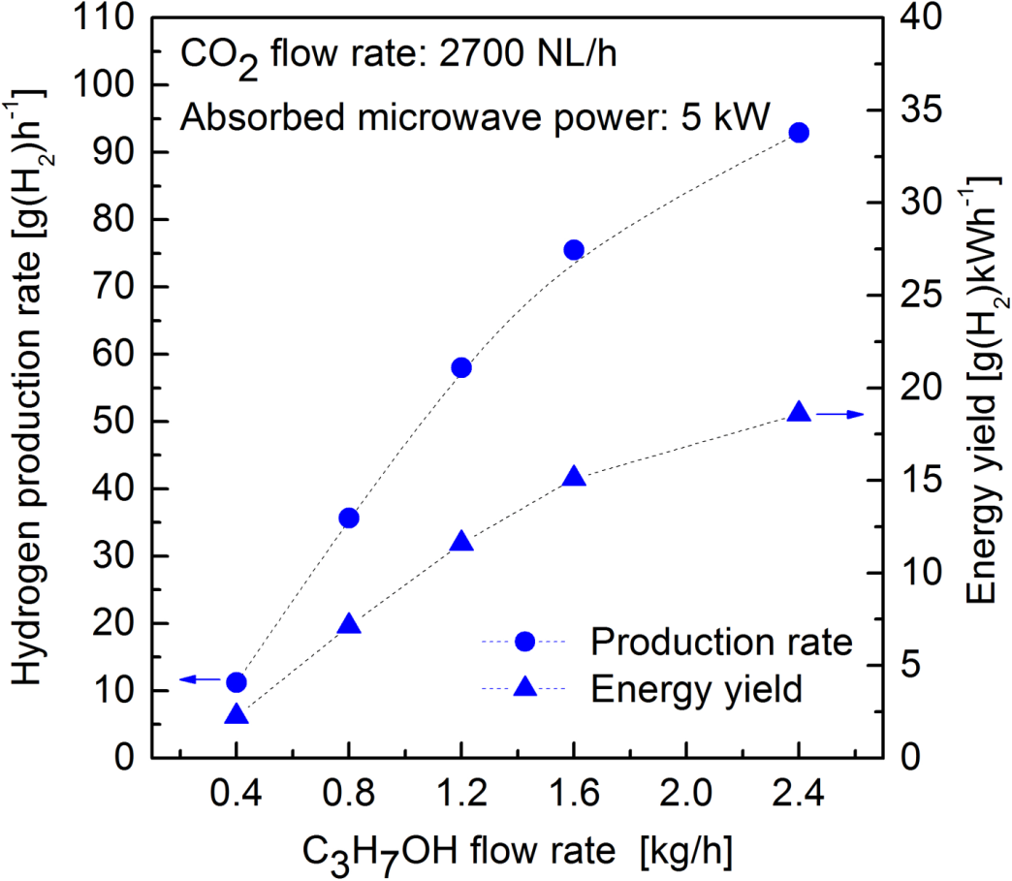
Dry reforming of isopropanol (C₃H₇OH + 2CO₂ → 4H₂ + 5CO)
915 MHz; C₃H₇OH added to axial flow
Best results: up to 92.9 g(H₂)/h and up to 18.6 g(H₂)/kWh
Corresponding hydrogen selectivity: up to 37 %
Hydrogen production rate and energy yield for CO₂ plasma as a function of absorbed microwave power (on the left) and as a function of C₃H₇OH flow rate (on the right).
31

Slide 32
Hydrogen production from ethanol - the best results
Absorbed microwave power [kW] | Working gas flow rate [NL/h] (reaction) | C₂H₅OH flow rate [kg/h] | Hydrogen production rate [g(H₂)/h] | Energy yield [g(H₂)/kWh] | Hydrogen selectivity [%] | Products in the outgas [%]
4 | N₂ – 2700 + 0.5 kg/h H₂O (steam reforming) | 0.4 | 57.8 | 14.4 | 100 | N₂ – 70,2 H₂ – 21 CO₂ – 0.9 CO – 7.2 CH₄ – 0.3 C₂H₂ – 0.2 C₂H₄ – 0.1 C₂H₆ – 0.05
3 | N₂ – 3900 (pyrolysis) | 0.8 | 66.7 | 22.2 | 64 | N₂ – 71.7 H₂ – 17.5 CO₂ – 0.2 CO – 6.4 CH₄ – 1.8 C₂H₂ – 1.5 C₂H₄ – 0.8 C₂H₆ – 0.07
5 | N₂ – 3900 (pyrolysis) | 1.2 | 95.7 | 19.1 | 61 | N₂ – 67.5 H₂ – 23.4 CO₂ – 0.2 CO – 7.8 CH₄ – 1 C₂H₂ – 2.8 C₂H₄ – 0.25 C₂H₆ – 0.05

Slide 33
Hydrogen production from isopropanol - the best results
Absorbed microwave power [kW] | Working gas flow rate [NL/h] (reaction) | C₂H₅OH flow rate [kg/h] | Hydrogen production rate [g(H₂)/h] | Energy yield [g(H₂)/kWh] | Hydrogen selectivity [%] | Products in the outgas [%]
5 | CO₂ – 2700 (dry reforming) | 1.2 | 58.0 | 11.6 | 37.0 | H₂ – 16.5 CO – 46.7 CO₂ – 28.7 N₂ – 3.4 CH₄ – 2.3 C₂H₂ – 2.0 C₂H₄ – 0.4 C₂H₆ – 0.05
5 | CO₂ – 2700 (dry reforming) | 2.4 | 92.9 | 18.6 | 29.6 | H₂ – 23.5 CO – 37.8 CO₂ – 25.2 CH₄ – 6.4 C₂H₂ – 2.7 C₂H₄ – 2.1 N₂ – 2.1 C₂H₆ – 0.1
33

